Slide 1

Data Analytics in Cyber Security CT115-3-M (Version E)
Machine Learning Algorithms in Practice
Module Code & Module Title
Slide Title

Slide 2
TOPIC LEARNING OUTCOMES
At the end of this topic, you should be able to:
Understand different types of supervised learning algorithm.
Understand the operating details of each algorithm.
Module Code & Module Title
Slide Title

Slide 3
Machine Learning
To perform the tasks autonomously, machines need to learn.
For this they learn a selected model using examples (training data)
Training Data
Machine Learning
(For a choice of Model)
Model parameters
For a selected model, machines learn model parameters.
This process is commonly known as “model learning”
But what is a model?

Slide 4
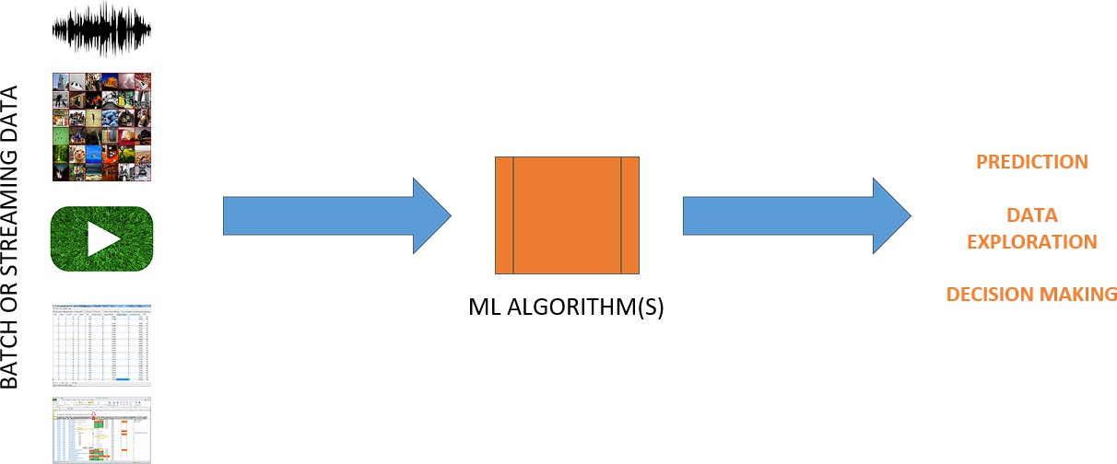
Machine Learning Models

Slide 5
Machine Learning Models
Learning is the process of adapting model parameters
of the classifier to produce a desired response.
Model parameters are commonly known as the weights
Hyperparameters are the knobs a data scientist gets to
turn when setting up a classifier.
  They are arguments to the function that affect the algorithm’s behavior, such as number of iterations, or options between variants of how the algorithm behaves.

Slide 6
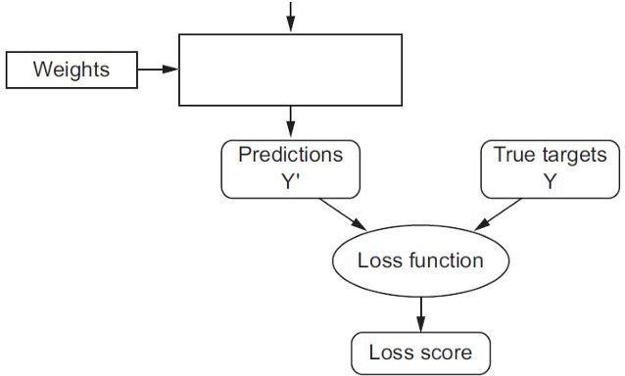
Input Row
 | Da | ta | set
A loss function (or error function) measures how far an estimated value is from its true value.
Hyper- Parameters
Loss Function
Optimiser
Behavior
Tuning
Classifier
( algorithms )
Loss function is applied to a single training example
Optimizer aims to minimize the cost function: the average loss over the entire training dataset.

Slide 7
Loss Function
A loss function (or error function) measures how far an estimated value is from its true value.
A loss function is for a single training example, and a cost function is the average loss over the entire training dataset.
– Classifier optimization strategies aim to minimize the
cost function
In essence, the loss function and the optimizer work together to fit the algorithm to the data in the best way possible.
There are many different loss functions and optimisers

Slide 8

Contents & Structure
Algorithms for supervised learning
Five general types
Module Code & Module Title
Slide Title
SLIDE 8

Slide 9
Algorithms for Supervised Learning
Support Vector
(various kernels)
Linear Models
Linear Regression
Logistic Regression
Linear Discriminant Analysis
Neural Network
Perceptron & MLP
Non-Linear Models
Naïve Bayes
k-Nearest Neighbours
Decision Tree
Ensemble
Bagging
Random Forest
Boosting
AdaBoost
Gradient Tree Boosting

Slide 10
Linear regression
Linear Regression fits a linear model ( y = 𝒂 + 𝒃𝑿 ) that best fits the relationship between the input variables (X) and the variable we will predict (y)
The slope of the line is b, and a is the intercept (the value of y when X = 0)
Different techniques can be used to learn the linear regression model from data, such as ordinary least squares and gradient descent optimization (these are hyperparameters for the classifier)
Scikit Learn Documentation
Slide <#> of 9

Slide 11
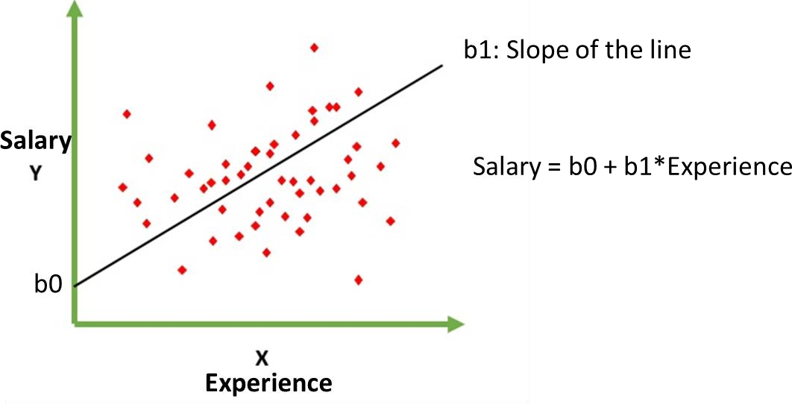
Linear Regression – Examples

Slide 12
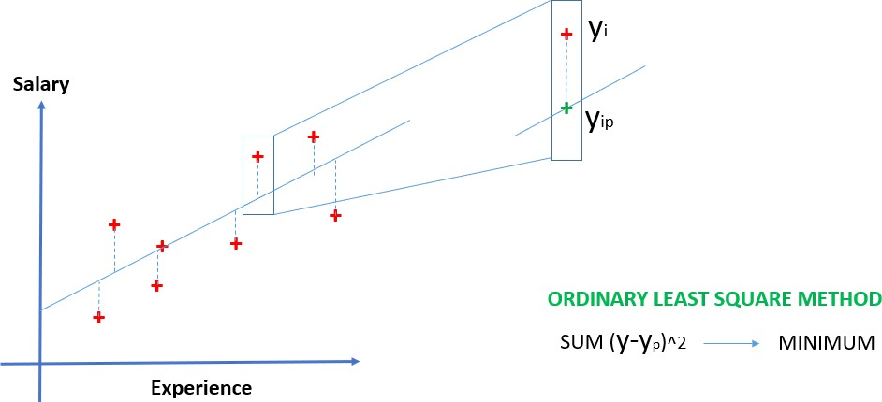
Linear Regression – Examples
In most common case, the line is determined by minimising the sum of the squares of the distances (vertical offset) of all points to points on the line.

Slide 13
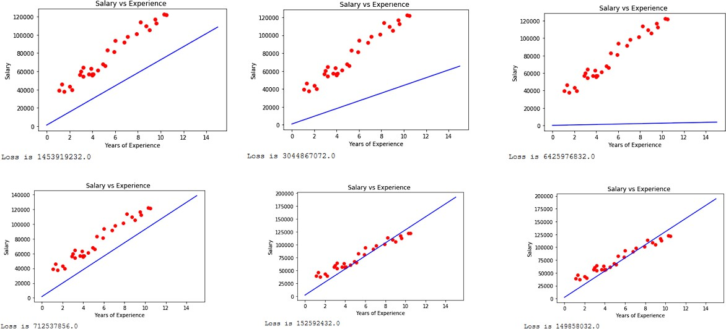
Linear Regression – Examples

Slide 14
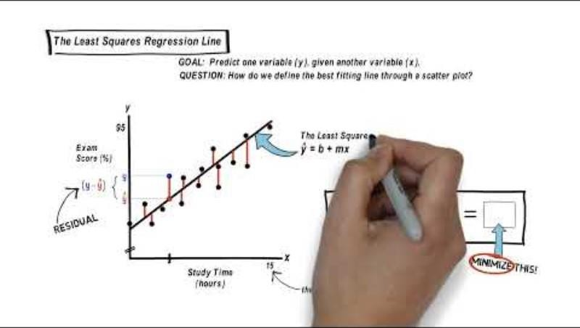
Linear Regression
https://youtu.be/aPHg1kGeKsg
Slide <#> of 9

Slide 15
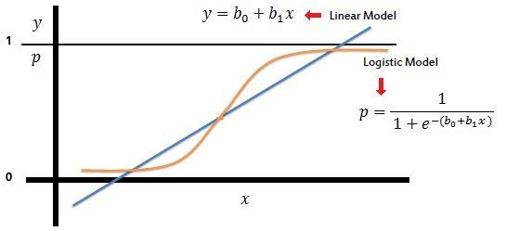
Logistic Regression
Logistic regression is the go-to method for binary classification problems (two class values).
Examples: Pass/Fail, Good/Bad, Defect/Not Defect,
Mammal/Not Mammal.
Does not assume a linear relationship between dependent and independent variables.
Unlike linear regression, the prediction is transformed using a logistic function
Slide <#> of 9

Slide 16
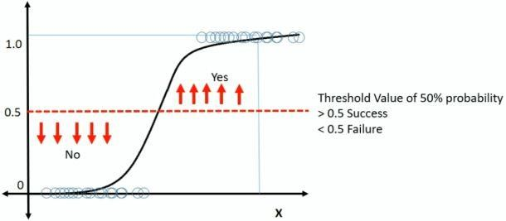
Logistic Regression
The logistic function will transform any value into the range 0 to 1
This is useful because we can apply a rule to the output of the logistic function to snap values to zero and one (e.g. IF less than 0.5 THEN output 0) and predict a class value.
Predictions made by logistic regression can also be used as the probability of a given data instance belonging to class 0 or class 1.
Scikit Learn Documentation
Slide <#> of 9

Slide 17
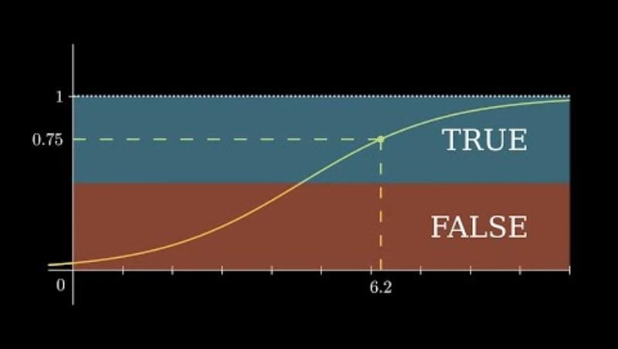
Logistic Regression
https://youtu.be/EKm0spFxFG4
Slide <#> of 9

Slide 18
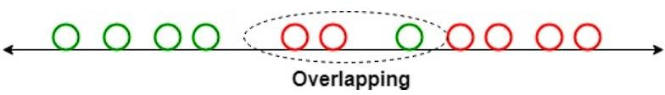
Linear Discriminant Analysis
LDA works by identifying a linear combination of features that separates or characterises two or more classes of objects or events.
LDA does this by projecting data with two or more dimensions into one dimension so that it can be more easily classified. The technique is, therefore, sometimes referred to as dimensionality reduction.
For example, we have two classes, and we need to separate them efficiently. Classes can have multiple features. Using only a single feature to classify them may result in some overlapping.
Slide <#> of 9

Slide 19
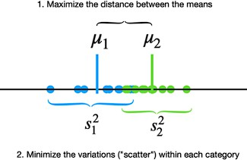

Linear Discriminant Analysis
LDA assumes that the data has a Gaussian distribution and that the covariance matrices of the different classes are equal. It also assumes that the data is linearly separable, meaning that a linear decision boundary can accurately classify the different classes. Two criteria are used by LDA to create a new axis:
Scikit Learn Documentation
Slide <#> of 9

Slide 20
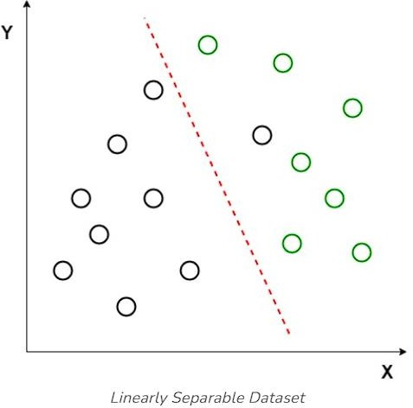
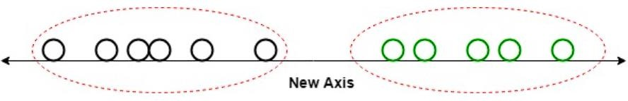
Linear Discriminant Analysis
Linear Discriminant Analysis uses both axes (X and Y) to create a new axis and projects data onto a new axis in a way to maximise the separation of the two categories and hence, reduces the 2D graph into a 1D graph.
Slide <#> of 9

Slide 21
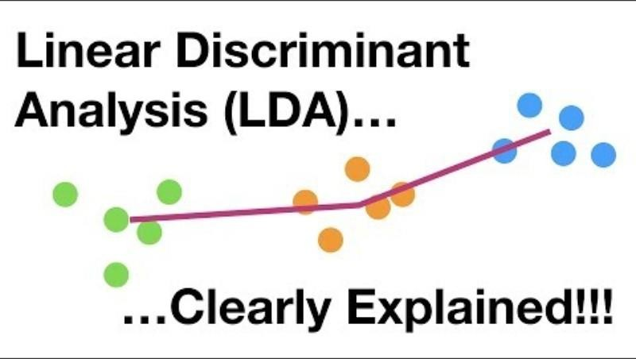
Linear Discriminant Analysis
https://youtu.be/azXCzI57Yfc?t=34
Slide <#> of 9

Slide 22
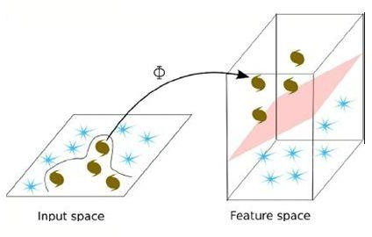
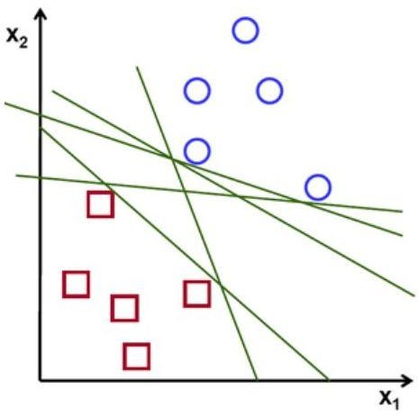
Linear Separators
Binary classification can be viewed as the task of separating 2 classes in feature space:
But which of the linear separators is optimal?
What if we cannot do it in two dimensions, but we could in 3?
Slide <#> of 9

Slide 23
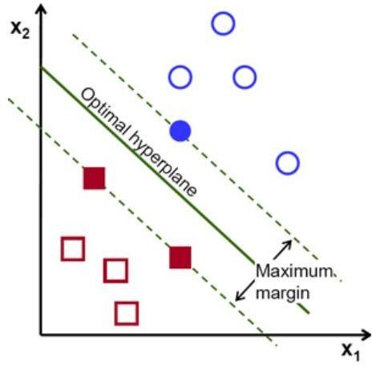
Linear Support Vector Machine (SVM)
Support Vector Machines can do both, based on the concept of a hyperplane that separates the classes
Observations on the margin are the support vectors that define the optimal hyperplane
Slide <#> of 9

Slide 24
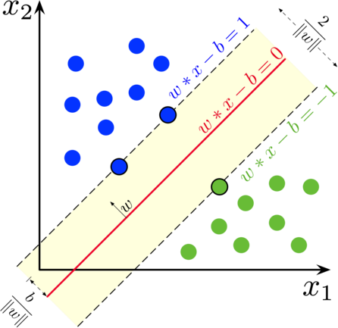
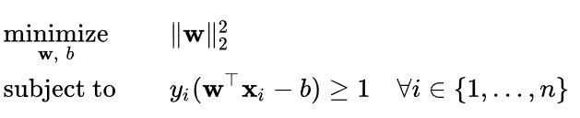
Linear SVM
Maximun Margin classification is strictly based on observations at the margin between classes.
An important consequence of this geometric description is that the max-margin hyperplane is completely determined by those points lie nearest to it, called support vectors.

Slide 25
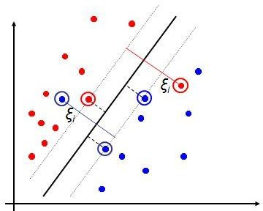
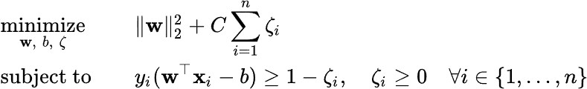
Soft Margin Classification
Parameter C is used for controlling the outliers: low C implies we are allowing
more outliers; high C implies we are
allowing
fewer outliers.
Scikit Learn Documentation

Slide 26
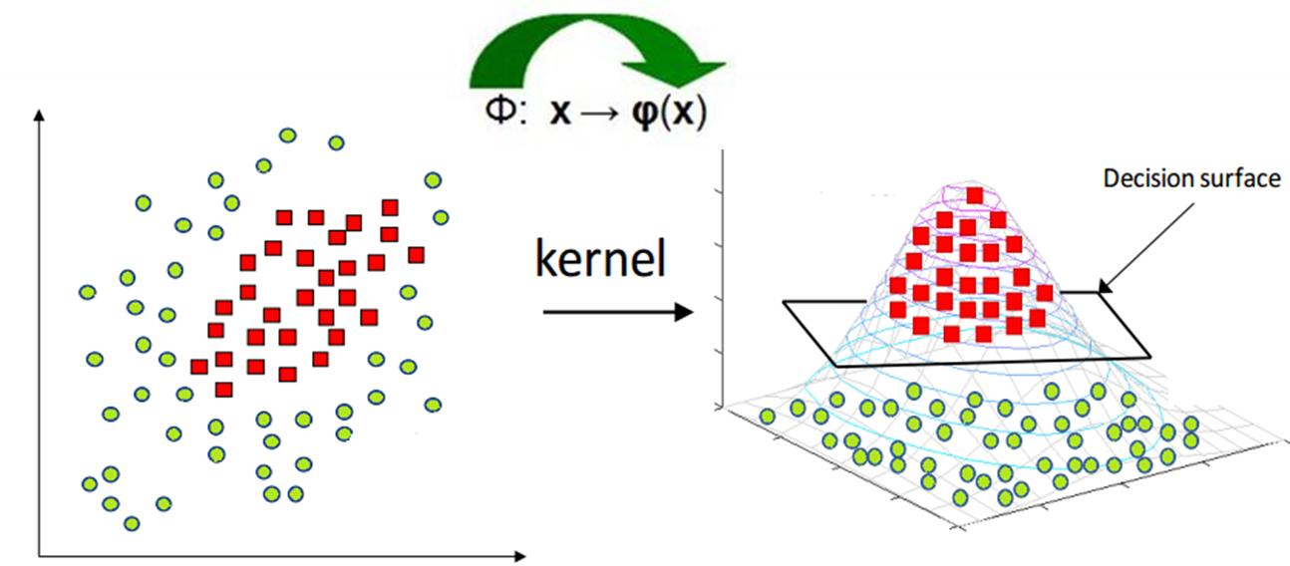
SVM Kernel
Kernelization maps non-linear data into another space which may either be of same dimension or higher dimension to improve the linear separability.
Scikit Learn Documentation

Slide 27
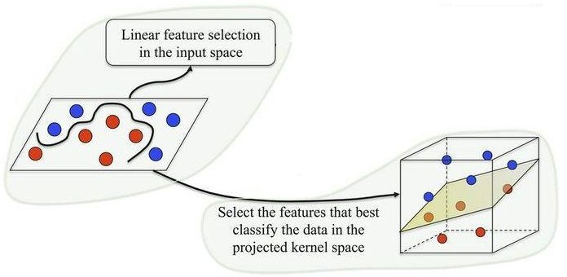

SVM Kernel
Kernelization is helpful if the right kernel can be found.
However, finding the suitable kernel is often a challenge.
Observations on the margin are the support vectors that define the optimal hyperplane
The line looks like a plane in 3d

Slide 28
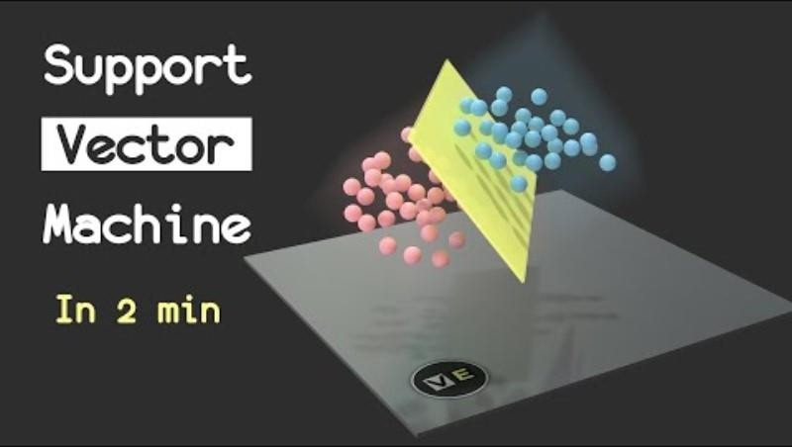
SVM
https://youtu.be/_YPScrckx28
Detailed Explanation (with Math): https://youtu.be/ny1iZ5A8ilA
Slide <#> of 9

Slide 29
Non-Linear Algorithms
Nonlinear machine learning algorithms do not make strong assumptions about the form of the mapping function
By not making assumptions, they are free to learn any functional form from the training data.
Nonlinear methods may achieve better accuracy at the expense of requiring more data and training time.

Slide 30
Naïve Bayes
The Naïve Bayes model is comprised of two types of probabilities that can be calculated directly from the training data:
  The probability of each class.
  The conditional probability for each class given each x value
Once calculated, the probability model can be used to make predictions for new data using Bayes Theorem.
It is common to assume a Gaussian distribution (bell curve)
Naive Bayes is called naive because it assumes that each input variable is independent.
This is a strong assumption and unrealistic for real data
Nevertheless, the technique is very effective on a large range of
complex problems.
Scikit Learn Documentation
Slide <#> of 9

Slide 31
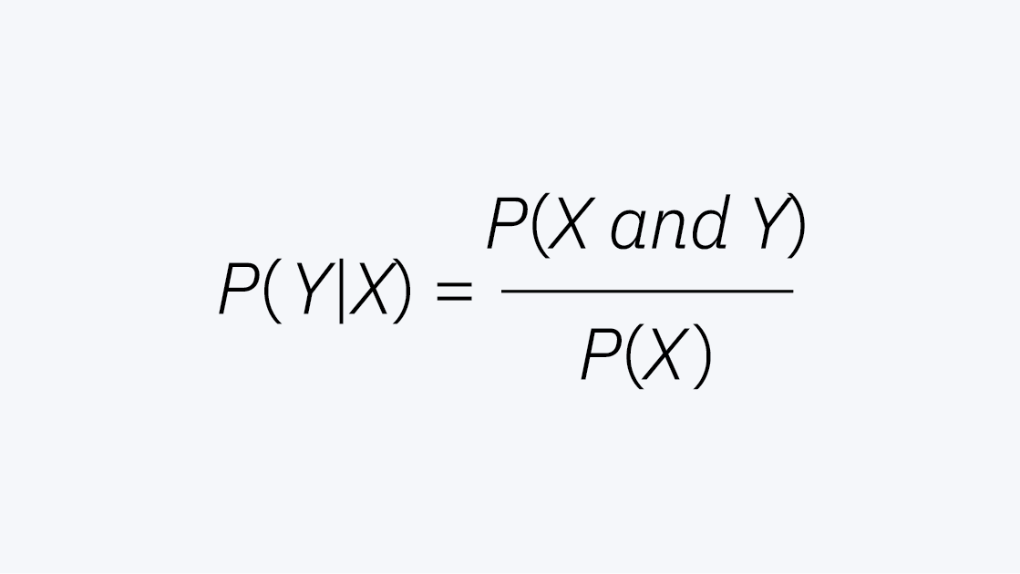
Naïve Bayes
The Naïve Bayes model is comprised of two types of probabilities that can be calculated directly from the training data:
  The probability of each class.
  The conditional probability for each class given each x value
Slide <#> of 9

Slide 32
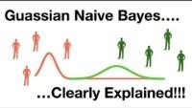
Naive Bayes
https://youtu.be/H3EjCKtlVog?t=47
Slide <#> of 9

Slide 33
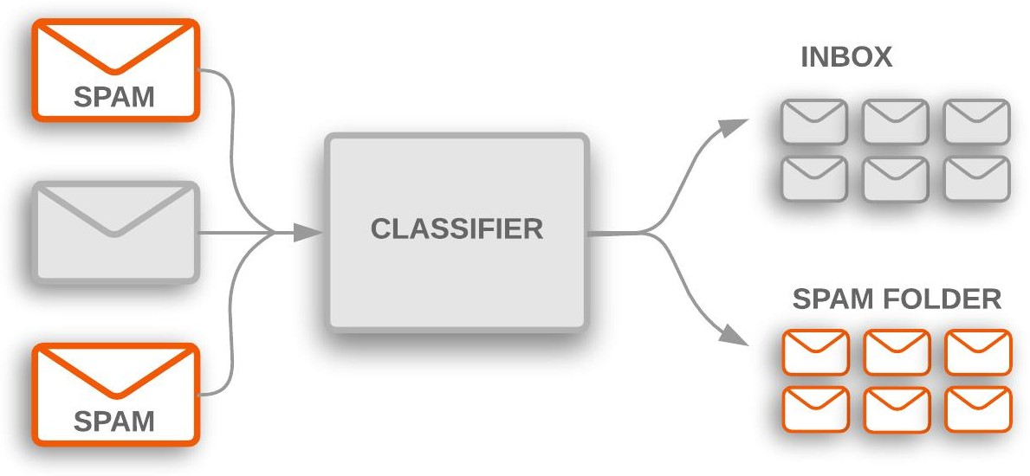
Applications of NB
Naive Bayes is mostly applied to:
  real time classification - the speed of Naive Bayes allows it to classify things in real time
  text classification - Naive Bayes functions well for text classification. It is popularly used for categorizing news, sentiment analysis, and to identify spam email.
Slide 33 of 35

Slide 34
k-Nearest Neighbors
The KNN algorithm is simple and effective but can be very slow
The model representation for KNN is the entire training dataset. This approach is known as a lazy learner
Predictions are made for a new data point by searching through the entire training set for the K most similar instances (the neighbours) and summarizing the output variable for those K instances.
The trick is in how to determine the similarity between the data instances. The simplest technique if your attributes are all of the same scale (all in inches for example) is to use the Euclidean distance, a number you can calculate directly based on the differences between each input variable.
Slide <#> of 9

Slide 35
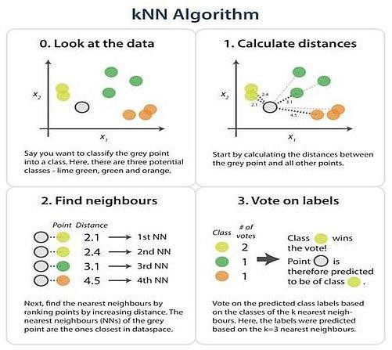
Slide <#> of 9

Slide 36

k-Nearest Neighbors
https://youtu.be/0p0o5cmgLdE
Slide <#> of 9

Slide 37
KNN
KNN can require a lot of memory or space to store all of the data, but only performs a calculation (learns) when a prediction is needed, just in time.
How to choose a good value of k for a particular dataset? Try several different values and compute the error rate using cross-validation.
The idea of distance or closeness can break down in very high dimensions (lots of input variables) which can negatively affect the performance of the algorithm on your problem. This is called the curse of dimensionality. It means you need to only use the input variables that are most relevant to predicting the output variable (feature selection).
Scikit Learn Documentation
Slide <#> of 9

Slide 38
Decision Trees
The representation of the decision tree model is a binary tree, straight from the algorithms and data structures textbook.
Each node represents a single input variable (x) and a split point on that variable (assuming the variable is numeric).
The leaf nodes of the tree contain an output variable (y) which is used to make a prediction. Predictions are made by walking the splits of the tree until arriving at a leaf node and output the class value at that leaf node.
Scikit Learn Documentation
Slide <#> of 9

Slide 39
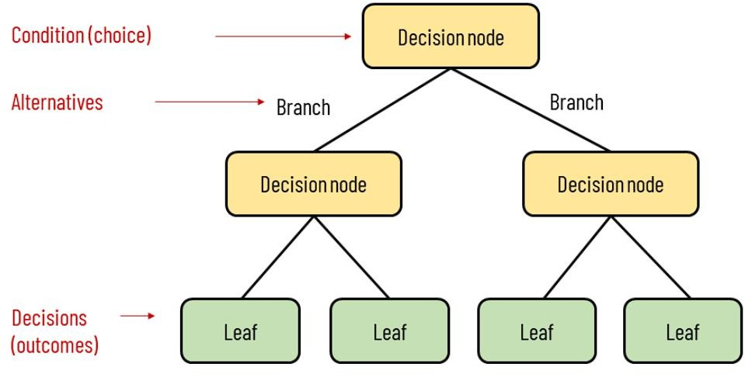
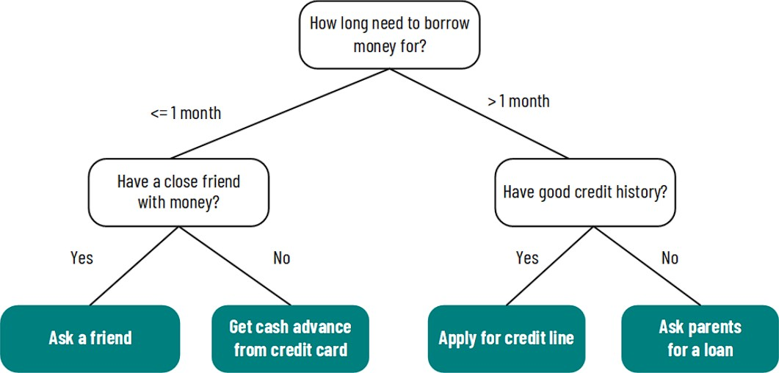
Decision Trees
Slide <#> of 9

Slide 40

Example 1 - Decision Tree
Splitting Attributes
Tid | Refund | Marital Status | Taxable Income | Cheat
1 | Yes | Single | 125K | No
2 | No | Married | 100K | No
3 | No | Single | 70K | No
4 | Yes | Married | 120K | No
5 | No | Divorced | 95K | Yes
6 | No | Married | 60K | No
7 | Yes | Divorced | 220K | No
8 | No | Single | 85K | Yes
9 | No | Married | 75K | No
10 | No | Single | 90K | Yes
Refund
Yes
No
NO
MarSt
Single, Divorced
Married
TaxInc
NO
< 80K
> 80K
NO
YES
10
Training Data
Model: Decision Tree
Slide 40 of 43

Slide 41

Example 2 - Decision Tree
MarSt
Single,
Divorced
Married
Tid | Refund | Marital Status | Taxable Income | Cheat
1 | Yes | Single | 125K | No
2 | No | Married | 100K | No
3 | No | Single | 70K | No
4 | Yes | Married | 120K | No
5 | No | Divorced | 95K | Yes
6 | No | Married | 60K | No
7 | Yes | Divorced | 220K | No
8 | No | Single | 85K | Yes
9 | No | Married | 75K | No
10 | No | Single | 90K | Yes
NO
Refund
Yes
No
NO
TaxInc
< 80K
> 80K
NO
YES
There could be more than one tree that
fits the same data!
10

Slide 42

Decision Tree
https://youtu.be/7YTeMIq6-9s

Slide 43
Generic Tree Growing Algorithm
Start with entire dataset and create a root node.
Select the best attribute – the one that best splits data based on a chosen metric.
Split the dataset into subsets based on selected
attribute.
For each subset, create a child node and assign subset to this node.
Repeat recursively Steps 2 – 4 until one of the
stopping criteria is met.
Assign most common class label of the instances in the node to the leaf node.

Slide 44
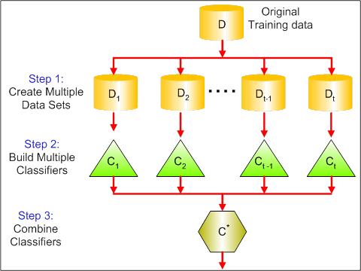
Ensemble Methods
(bagging)
Use different sub-samples of the data set
Combine results from multiple instances of a classifier
Voting Algorithm
Goal is to reduce the
variance of predictions

Slide 45
Ensemble Methods
Use different sub-samples of the data set
Combine results from multiple instances of a classifier
Goal is to reduce the variance of predictions
In Bagging, data subsets are drawn randomly with
replacement from the training dataset at the beginning
In Boosting, every new subset comprises the elements that were misclassified by previous models
In Bagging, classifiers run in parallel, and results are
aggregated when all of them finish
In Boosting, classifiers run in sequence, and results are aggregated at the end of each run

Slide 46

Random Forest
Random Forest is a bagging method that uses a large number of deep trees, fitted on bootstrap samples
The Random forest algorithm adds the concept of random feature subspace selection to create more robust models:
– In addition to sampling the observations in the dataset we also sample the features, and keep only a random subset of them to generate each bootstrap sample
This means all trees use different information to make their decisions, which reduces the correlation between their outputs
Scikit Learn Documentation
Slide <#> of 9

Slide 47
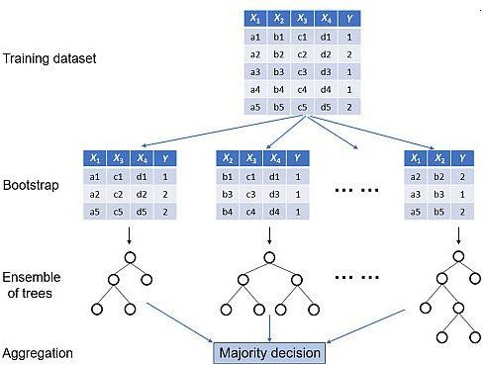
Random Forest
Slide <#> of 9

Slide 48
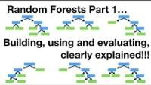
Random Forest
https://youtu.be/J4Wdy0Wc_xQ?t=9
Slide <#> of 9

Slide 49
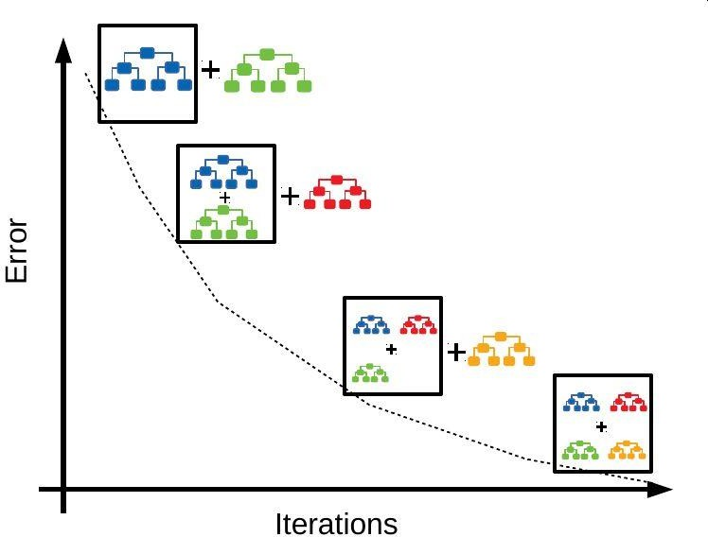
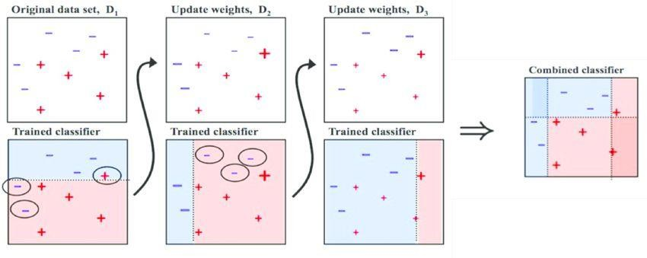
Boosting classifiers aggregate the individual predictions of several instances of an estimator on repeatedly modified versions of the data.
Boosting starts with one instance, and adds new instances one after another
Each model in the sequence is fitted giving more importance to observations in the dataset that were misclassified by the previous models in the sequence
This is done based on the the loss function and weighting

Slide 50
AdaBoost (Adaptive boosting)
Train model on train set with equal weights for all samples
Compute error of model on train set
Increase weights on train cases model gets wrong
Train new model on re-weighted train set
Go back to step 2 - Repeat until tired (100+ iterations)
Scikit Learn Documentation
Slide <#> of 9

Slide 51
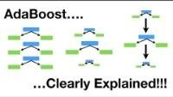
AdaBoost (Adaptive boosting)
https://youtu.be/LsK-xG1cLYA?t=11
Slide <#> of 9

Slide 52
Gradient Boosting
AdaBoost was the first really successful boosting algorithm developed for binary classification
Actually uses short decision trees
Gradient boosting is similar to AdaBoost but uses
a different process to fit the trees sequentially
  Construct a base tree
  Build the next tree based on errors of the previous tree
  Combine the previous tree with new tree
  Go back to step 2 - Repeat until tired (100+ iterations)
    Scikit Learn Documentation
Slide <#> of 9

Slide 53
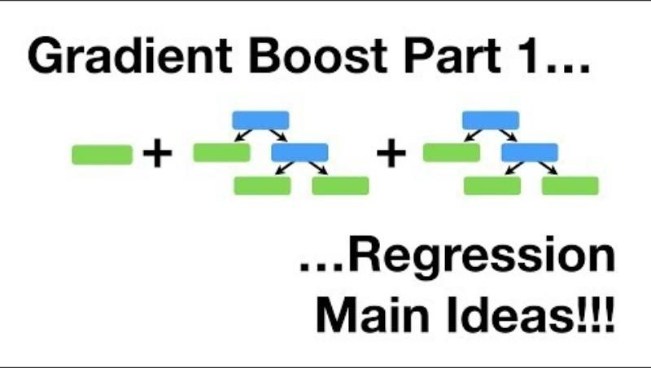
Gradient Boosting
https://youtu.be/3CC4N4z3GJc?t=10
Slide <#> of 9

Slide 54
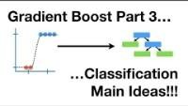
Gradient Boosting
https://youtu.be/jxuNLH5dXCs?t=17
Slide <#> of 9

Slide 55
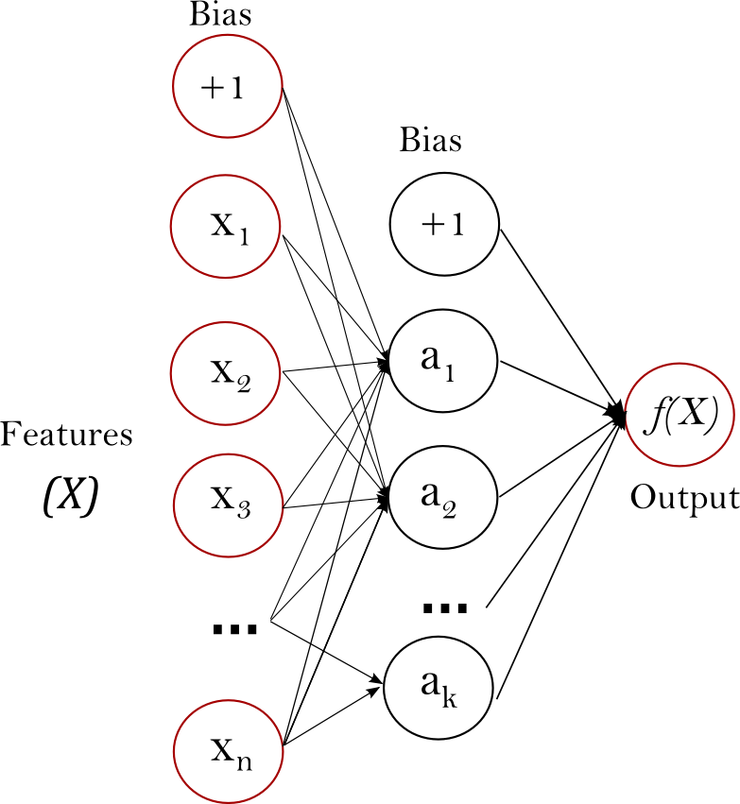
Neural Network
Neural networks are complex models, which try to mimic the way the human brain develops classification rules. A neural net consists of many different layers of neurons, with each layer receiving inputs from previous layers, and passing outputs to further layers.

Slide 56
Neural Network
The learning (training) process of a neural network is an iterative process in which the calculations are carried out forward and backward through each layer in the network until the loss function is minimized.
Fundamentally, three steps are involved:
  Forward propagation (Forward pass)
  Calculation of the loss function
  Backward propagation (Backward pass/Backpropagation)
Scikit Learn Documentation

Slide 57
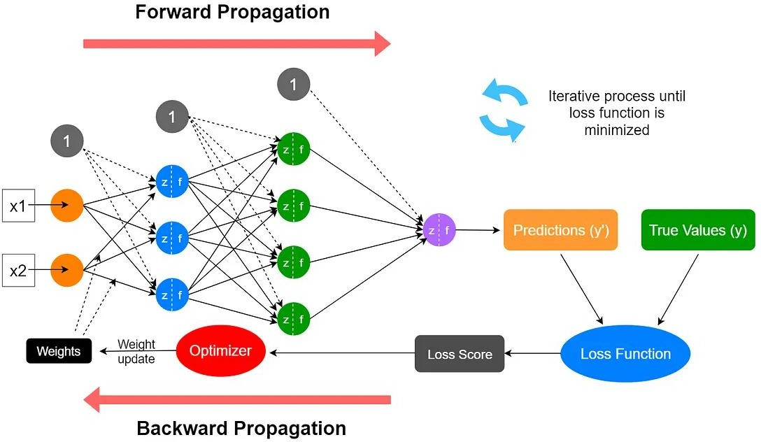
Neural Network

Slide 58
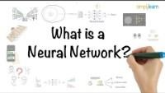
Neural Network
https://www.youtube.com/watch?v=bfmFfD2RIcg

Slide 59
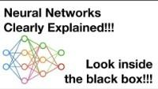
Neural Network
https://www.youtube.com/watch?v=CqOfi41LfDw&t=1s

Slide 60
Estimator Selection
No a-priori best estimator; must experiment
The estimator selection and evaluation phases provide information that can be used to refine feature selection, transformation, and scaling.
In practice, this means starting off by generating predictions with a set of candidate algorithms, comparing their performance in terms of predictive accuracy, and making judgements which one have the most potential.

Slide 61
Review Questions
What are the four types of supervised learning algorithms?
How each supervised learning algorithms are trained?
Module Code & Module Title
Slide Title

Slide 62
Summary / Recap of Main Points
At the end of this topic, you should be able to:
Understand different types of supervised learning algorithms
Understand the operating details of each algorithms.
Module Code & Module Title
Slide Title

